Slide 1
PACT
Lecture 3

Slide 2
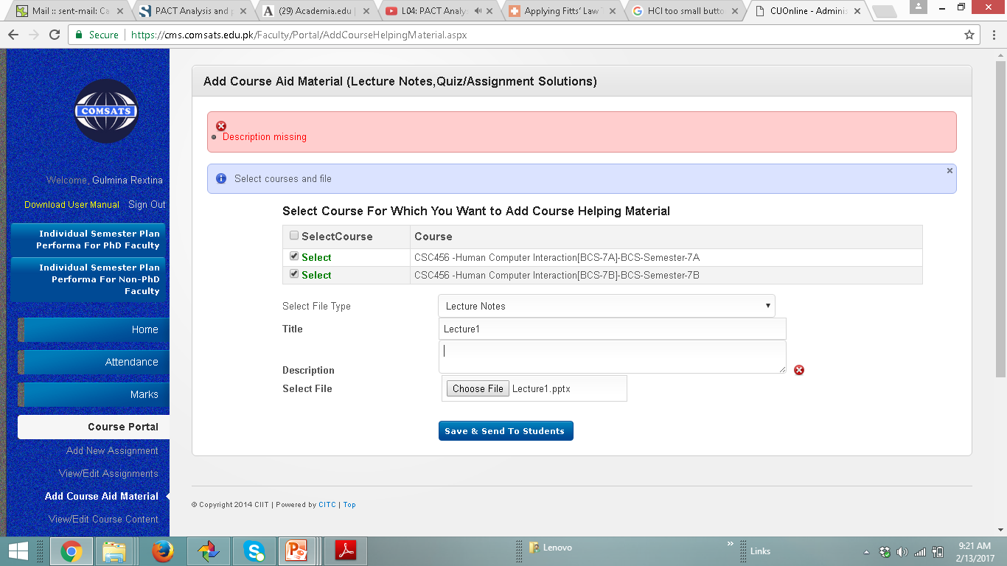

Slide 3
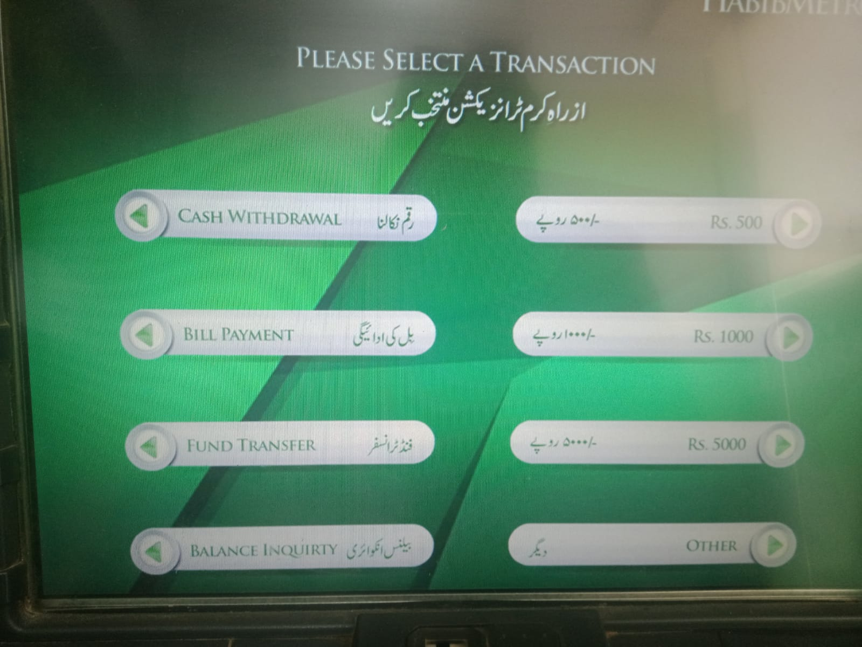

Slide 4
PACT
a useful framework for thinking about a design
situation
PACT stands for
People
Activities
Context
Technology

Slide 5
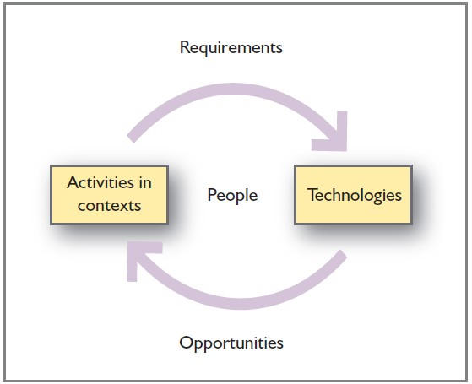

Slide 6
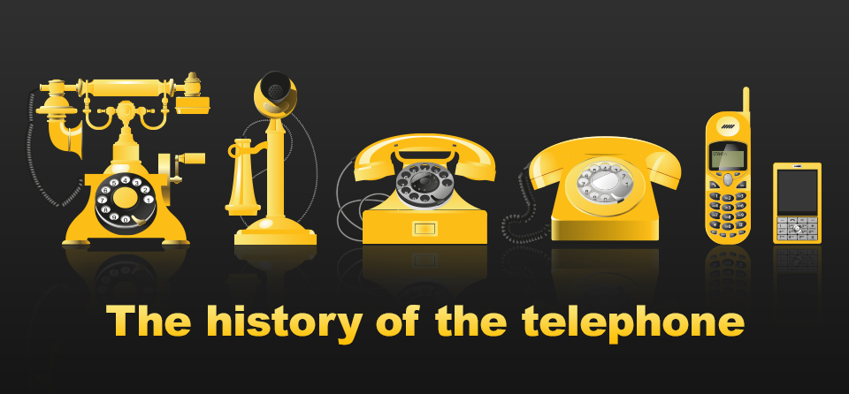
The changing nature of telephoning activity as technology advances
What about the activity of watching film?

Slide 7
Twitter or Facebook
Think about the original use and how are we using it now.
What opportunities has it presented?

Slide 8
PEOPLE
People are different in their physical
characteristics, abilities and character
We need to consider the following when we think about the people who will use a system
Physical differences
Ergonomics
Psychological differences
Mental models
Social differences

Slide 9
PHYSICAL DIFFERENCES
People
People can have different height weight etc.
Variability in our five senses
We have to consider people who might be
short sighted
Hearing impaired
Colour blind (affects about 8 per cent of Western males)
Visually impaired
Wheel chair users
Buttons can be made extremely small but then will we able to press them?

Slide 10
ERGONOMICS
People → Physical Differences
The term ‘ergonomics’ was coined in 1948 to describe the study of the relationships between people and their environment
The environment includes the ambient environment
Temperature
Humidity
Light
Noise
Also working environment
Design of machines
Health
safety

Slide 11
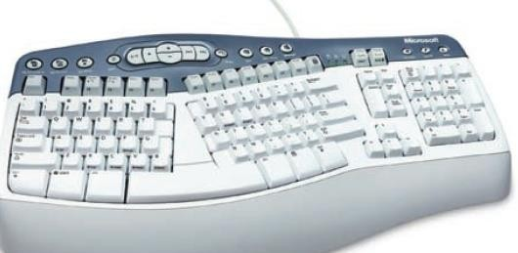
People → Physical Differences
ERGONOMICS

Slide 12
ERGONOMICS
People → Physical Differences
Ergonomics has much to tell us about the design of interactive devices such as a mobile games console
In the world of mobile computing, small is good but too small is bad (too easily lost, too difficult to use, too easily eaten by the dog).
Ergonomics can put numbers on what constitutes
small and usable and what is too small and unusable.
One such example is Fitts law

Slide 13
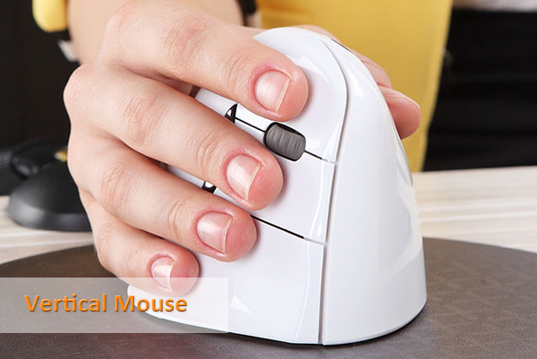
Bad Ergonomic Design

Slide 14

FITTS LAW
People → Physical Differences→Ergonomics
Fitts’ law is a mathematical formula which
relates the time required to move to a target as a function of the distance to the target and the size of the target itself, say moving a pointer using a mouse to a particular button.
Fitts’ law describes motor control.
The smaller the target and the greater the distance, the longer it will take to hit the target.

Slide 15
Below, time will be the same because the ratio d/s is the same
Target 1
Target 2

Slide 16
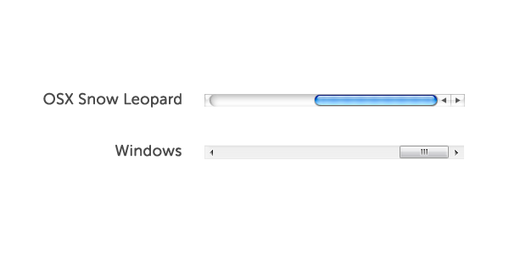
Fitts’s Law
http://webdesign.tutsplus.com/articles/applying-fitts-law-to-mobile-interface-design--webdesign-6919

Slide 17
Fitts’s Law
Most design guidelines as for a minimum button size and distance from other interactive elements.
It’s also important to account for high risk interactive elements that you don’t want the user to accidentally activate.
Those should often be kept further away from heavily used interactive items.

Slide 18
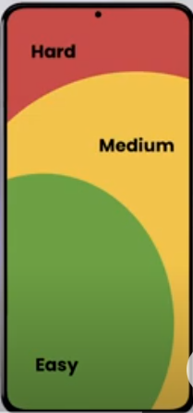
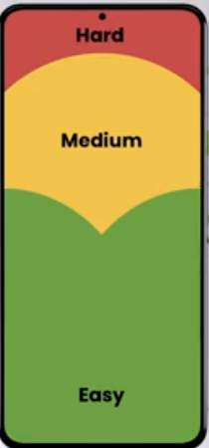
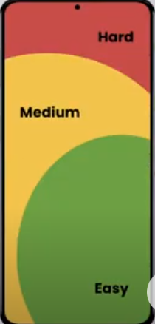
Left Handed People
Using Both Hands
Right Handed People

Slide 19
PSYCHOLOGICAL DIFFERENCES
People → Psychological Differences
Psychologically, people differ in a variety of ways.
people with good spatial ability will find it much easier to find their way around and remember a website than those with poor ability
Designers should design for people with poor ability by providing good signage and clear directions.
Language differences are of course crucial to
understanding
cultural differences affect how people interpret things.

Slide 20
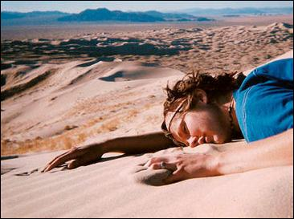
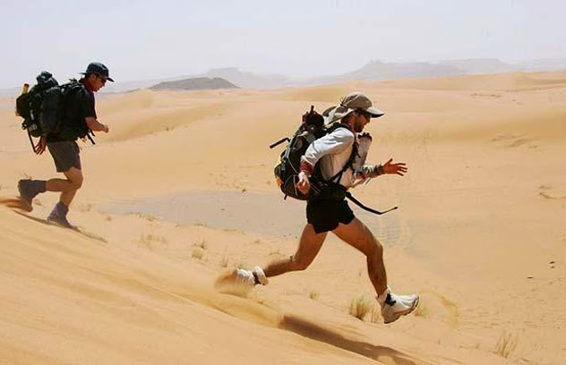
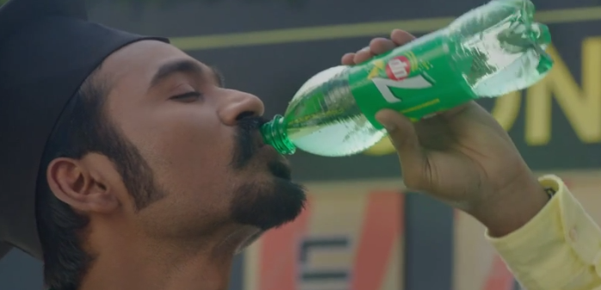
Cultural Differences

Slide 21
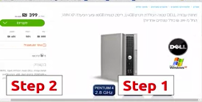

Slide 22
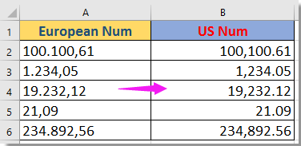
Cultural Differences

Slide 23
PSYCHOLOGICAL DIFFERENCES
People → Psychological Differences
In the USA a tick is used for acceptance and a
cross for rejection,
In Britain a tick or a cross can be used to show acceptance (e.g. a cross on a voting paper).
Care must be taken when designing icons that they don’t have a negative meaning in the target culture.
People can have different abilities when it comes to memory and attention and theses can change with circumstances

Slide 24
SOCIAL DIFFERENCES
People → Social Differences
People make use of systems, products and services for very different reasons. They have different goals in using systems.
They have different motivations for using
systems.
Some people will be very interested in a particular system, others will just want to get a simple task completed. These motivations change at different times.

Slide 25
SOCIAL DIFFERENCES
People → Social Differences
Designing for homogeneous groups of people –
groups from designing for heterogeneous groups.
Websites have to cater for heterogeneous groups and have particular design concerns as a result.
A company’s intranet, however, can be designed
to meet the particular needs of particular people

Slide 26
ACTIVITIES
People → Activities
The term is used for very simple tasks as well as highly complex, lengthy activities, so designers need to be careful when considering the characteristics of activities.

Slide 27
ACTIVITIES
People → Activities
Designers need to consider
 overall purpose of the activity
The above point is the most crucial when considering activities

Slide 28
ACTIVITIES
People → Activities
After the overall purpose the following ten points
need to be considered by the designer
how regular or infrequent activities are. (making a phone call vs changing battery)
time pressures, peaks and troughs of working.
A design that works well when things are quiet can be awful when things are busy. (buying a ticket from a machine when there is a queue)
Some activities will take place as a single, continuous set of actions whereas others are more likely to be interrupted.
It is important then to ensure that people do not make mistakes or leave important steps out of some activity
They should be able to find their place again
Temporal

Slide 29
ACTIVITIES
The response time needed from the system must be
considered
If a website takes two minutes to deliver a response when the server is busy, that may be frustrating for a normal query but it could be critical if the information is needed for some emergency.
Activity will be performed alone or with others
Issues of awareness of others and communication and coordination then become important
Well-defined tasks need different designs from more vague tasks
If a task or activity is well defined it can be accomplished
with a simple step-by-step design
A vague activity means that people have to be able to browse around, see different types of information, move from one thing to another and so on.
Temporal
Cooperation
Complexity

Slide 30
ACTIVITIES
Is an activity safety critical
where safety is involved designers must pay every attention to ensuring that mistakes do not have a serious effect
In general, it is vital for designers to think about what happens when people make mistakes and errors and to design for such circumstances.
Data requirements
If large amounts of data need to be entered then a keyboard is a good choice
However other options can be considered when data input requirement is not that high such as a bar code reader in a library
Media that an activity requires
A simple two tone display of numeric data demands a very different design from a full-motion multimedia display.
Safety Critical
Nature of Content

Slide 31
ACTIVITIES
List the main characteristics of the activity of sending an e-mail. Use the 10 points above to guide you.

Slide 32
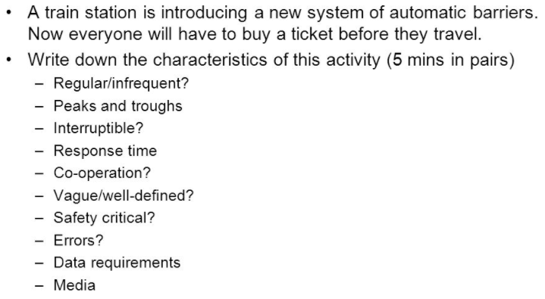
Activity: Designing a ticket machine

Slide 33
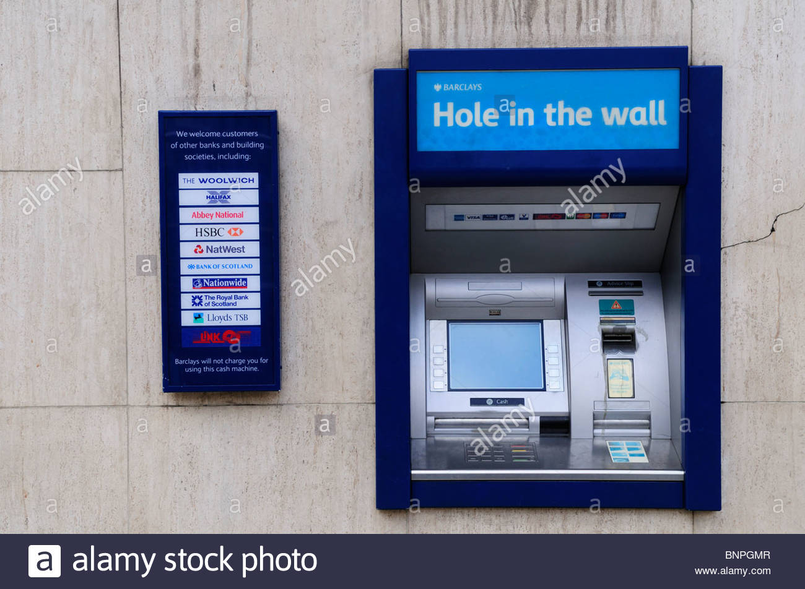
CONTEXT
Context
Activities always happen in a context, so there is
a need to analyze the two together.
 ATMs in different countries
○ .

Slide 35
PHYSICAL ENVIRONMENT
Context→Phyiscal Environment
The physical environment in which an activity
happens is important
for example, an analysis of context would include things such as the location of the device (often as a ‘hole-in-the-wall’),
the effect of sunshine on the readability of the display, and security considerations
The same activity – for example, logging on to a website – may be carried out in geographically remote environments where Internet access is slow, or with all the facilities of a large city and fast networks

Slide 36
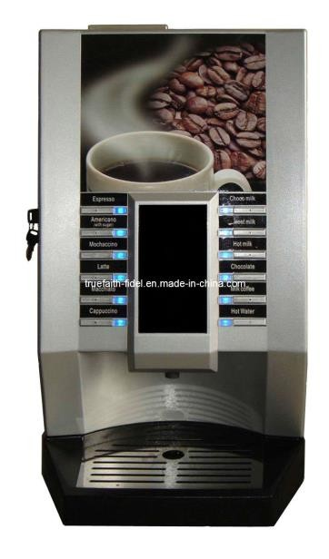
SOCIAL CONTEXT
Context→Social Context
The social context within which the activity takes
place is also important
There may be privacy issues to consider, and an interaction can be very different if the person is alone compared to being with others.
 Getting coffee from an unfamiliar coffee machine in an office for example

Slide 37
SOCIAL CONTEXT
Social norms may dictate the acceptability of
certain designs.
 For example, the use of sound output is often unacceptable in an open-plan office environment, but might be quite effective where a person is working alone

Slide 38
ORGANIZATIONAL CONTEXT
Finally the organizational context is important as changes in technology often alter communication and power structures and may have effects on jobs such as deskilling.

Slide 39
TECHNOLOGIES
The final part of the PACT framework is the technologies; the media that interactive system designers work with
Designers need to be aware of various possibilities for input, output, communication and content

Slide 40
Technologies
Input - Getting data in; getting commands; security
Output - Characteristics of different displays (e.g. video vs. photographs; speech vs. screen)
Communications - Between people, between devices, speed, etc. - What is connected to what?
Size of screen
GUI or not?
Sound?
Networked or stand alone.
Real-time systems;
Safety critical systems;
Walk-up-and-use systems (e.g. kiosks) / Office systems / Palm pilot application / Web site.

Slide 41
How to Carry Out P,A,C,T?
Task List
Brainstorm the variety of P, A, C and T’s that are possible
Explore design implications
Look for trade-offs between combinations of PACT
Think about how these might effect design
Conditions Required
Some information about (similar) system is required
Marketing personnel may be involved also

Slide 42
Example 1: PACT Analysis of University Attendance System
This attendance system is focused on marking and recording the time and attendance of both students and staff members of the University
People Analysis
Primary Stakeholders – Students (Undergraduate, Postgraduate), Academic Staff Members, Non Academic Staff Members
Secondary Stakeholders – Board of Management, Ministry of Higher Education, Parents. Etc
Physical Aspects
System will be used by people from 18 years to approximately 70 years of age.
There will be both male and female users.
There can be people with some disabilities which limit the physical function of one or more limbs or fine or gross motor ability. (e.g. visual impairment, hearing impairment, Mobility impairment, etc).
Psychological Aspects
Stakeholders are multi-cultural and are using multi-language (with different language skills).
Almost all the stakeholders have good educational level. Therefore learning new technologies, level and duration of attention will be good.

Slide 43
Usage
Students will need to mark their attendance to fulfill the requirement of 80% attendance for lectures and confirm their participation in practical sessions and assignments.
Non academic staff members will use the system to mark their working hours, attendance in order to process their salary requirements.
Activities
Student Attendance Marking
The university is using paper passed attendance sheet system for students. When students are participating for a lecture, practical session or an assignment an attendance sheet will be passed among them. (With lecture time, subject and place) Students are marking it by putting their signatures correspond to their name. After the sheets collected by academic and publications branch, they will record those data.
Non Academic Staff Attendance Marking
Time and attendance marking of non academic staff members is done by using finger print machine. When an employee is first enrolled in a fingerprint-based bio-metric time and attendance system, the software records a template of the employee’s fingerprint and associates that template with the employee’s ID number. This template measures the relationship between various points in the fingerprint.
Each time the employee attempts to clock in or out, the time and attendance software verifies that the newly scanned fingerprint matches the template originally stored for that ID number. If there is a match, now, the employee in time with date and time is recorded. Employee’s time out is also recorded in the same way when the employee leaves the office.

Slide 44
What should be improved?
In these activities sometimes users can be forget to mark their attendance. Also there can be situations such as lecturer forgets to bring the attendance sheet to the lecture hall likewise. On the other hand attendance sheets can be easily misplaced.
Students can misuse the system by putting their friend’s signature, alternating the signatures in the attendance sheet.
Manually checking and recording the attendance of each student for examination and other purposes is a huge time consuming process and it can also generate higher rate of errors. On peak times non academic staff members will have to wait in a queue to put their finger print in the machine.
Finger prints may be have problems such as not recognizing, not properly processed.
Activity Attributes
It is not safety-critical, but reliability is an important aspect.
Both of these activities can happen often. Students’ attendance marking is done every time there is a lecture, practical or an assignment. And non academic staff members will mark their attendance daily (when they start their work and leaving the work).

Slide 45
Context
Physically, this activity takes place at any time of the day in an indoor environment (lecture hall, laboratory or an examination hall). Presence of each individual is essential. Sometimes Humidity of the environment may affect the using of finger print machine.
Socially, there will be no need of privacy to perform this task. Students mark the signing sheet while during the lectures and non academic staff members will put their in the machine where it is located.
Organizationally, this is primarily about student and employee administration. Regularly these activates will take place from 6.00am to 8.00pm in working days.
Technology
Current Technology
Marking the attendance of students is a manual process. Students mark their signature in the attendance sheet and those will be collected and recorded manually. Time and attendance marking of non academic staff members is done by using finger print machine. Fingerprint attendance system automates the attendance procedure using bio-metric technology.
Inputs: Student Signatures, Finger Print Images
Proposed System
To enhance the efficiency, effectiveness and reduce the misuses we can suggest the using of following technologies for the University attendance system.
Face Detection Technology
Handheld Finger Print Machine

Slide 46
Automatic face recognition attendance system
Face recognition time attendance is an advanced bio-metric application. It requires the user to enroll the facial details of all the students in a work place. Enrollment procedure consists of storing the unique and permanent facial characteristics of each individual in the database as templates. After enrollment, a suitable camera system should be placed in every lecture hall in order capture clear view of face of each student while attending the lecture. Cameras will automatically take the pictures and identity of students will be verified by the system and attendance will be marked on his behalf. The automatic face recognition attendance system was designed with the aim of marking attendance of the students present in a classroom based on facial recognition and give out a marked attendance sheet.
Advantages: The system provides an efficient way of marking and storing the attendance without having to physically call out the name of each student. It helps save time and the attendance shall be directly stored without having to maintain a physical record.
Handheld Finger Print Machine
For attendance marking of students Lectures can use Handheld Finger Print Machines. They can bring it to the lecture and pass it among students. Students would be made to place their finger over the sensor so as to mark their presence in the class. It can communicate with a host computer using its USB interface. This device operates from a rechargeable battery. GUI application in host computer helps the teacher to manage the device and attendance. Then, the attendances of the students will be recorded and kept in the database.
Advantages: By this option the university can stop misuses of current paper based attendance sheet system. Those who are in the lecture hall only be able to mark their attendance.
The device is portable and lightweight enable us to carry the device easily. Therefore, change of location of the lecture is not an issue.

Slide 47
Example 2: PACT Analysis for a Tourism Website
An essential part of our approach to designing the Interactive E-Tourist website is to make it as user-centred as possible.
We felt that performing a PACT analysis would be useful for both our analysis and design activities; understanding the current situations, seeing where possible improvements can be made and envisioning future situations.
With the PACT analysis we were able to bring together all our research on our target users and scope out the variety of different people, activities, contexts and technologies possible.
From the analysis we could develop clear and concrete scenarios of how our target users would be interacting with our E-Tourist website. The results of the PACT analysis are presented below:

Slide 48
People
Making sure that my website caters for people with disabilities such as visibility impairment (such as long/short sight, colour-blinded etc.).
Website to be accessible to those people who are not so able (for all levels of cognitive ability).
Computer Literacy/Knowledge
Users accessing our site may be beginners, intermediate or experts, it is therefore, essential for the website to cater for all its users. Because the site focuses on tourism in Edinburgh, our site will only be accessed when people are considering a trip to Edinburgh. So, it is most probable that even those users that are very computer/internet literate may still be beginners when they visit our website.
Cognitive Abilities
Because people are better at recognizing things than remembering them, our site will be primarily be 'see and click'. This is so that users will be able to easily interact with the website.
Physical Abilities
It is essential for our website to be accessible for those users that are physically challenged: users with sight difficulties.
Difficulty of seeing small things. We will need to make sure that the contents in our site can be magnified for such users - quality of the site is undisturbed when the information is magnified
The second difficulty is colour blindness (difficulty distinguishing between yellow and blue and red and green), make sure that colours that can affect colour-blindness are not mixed.
The third difficulty is moderate to fully blind users, we need to consider whether users can access the information in audio form. This is particularly important where images are used (describing the images in text form, in such a way that blind users can effectively understand the information about the images in the same way all other users can).
Web designers also need to consider whether or not information and/or the whole website can be converted into Braille. This is important for those users who prefer to use Braille over audio.

Slide 49
Activities
There are many activities that designers need to consider (simple and complex). Below are the main characteristics of activities that need to be considered:
Temporal aspect (regularity of activities): is the activity done everyday, monthly, or annually?
Temporal aspect (response time from the system): how long does the website take to download?
Nature of content (colors used in the website): they have to be deigned so that they are not an eye-sore
Nature of content (textual information): what font, size is going to be used?
Main activities is a navigation map of the royal mile.
It will have hotspots which people can click on→ a page with information on that page.
Forums and blogs for opinions etc.
Upload pictures of the city
What tours are available for them, for example family tours.
Search facility for users to use if the need to

Slide 50
Context
Activities constantly occur in a context
The context type that affects my website is the physical environment.
Physical environment- For example the website should cater for people who may be logging on to my web site in an area that has slow internet access
This will be a problem if they decide that the website is taking its time to upload.
Users will access the website in different places such as the home, workplace, educational institutions or internet cafes; therefore it is vital that the site is accessible for those visitors that use different resolutions, operating systems, color depths platforms and browsers.

Slide 51
Technologies
Technologies can carry out a variety of operations and usually consist of a lot of data, or information.
Interaction is required and so there is a need for a range of styles.
There are many different technologies that users can use
different operating systems browsers (JAWS (screen reader for blind user))
platforms (Windows, Macintosh etc)

Slide 52
Reading
http://webdesign.tutsplus.com/articles/applying-fitts-law-to-mobile-interface-design--webdesign-6919

